Slide 1
Learners who are Intellectually Disabled
Chapter 5
Copyright © Allyn & Bacon 2006
Notes:
1

Slide 2
Topics
Definition
Prevalence
Causes
Assessment
Psychological and Behavioral Characteristics
Educational Considerations
Early Intervention
Transition to Adulthood
Notes:
2

Slide 3
Introduction
Reasons for Caution when Identifying Students as Being Intellectually Disabled:
Concern about misdiagnosis of ethnic minorities---
Possible stigma associated with the diagnosis
Concerns related to “Intellectually Disabled” being a socially constructed condition

Slide 4
Myths and Facts
1. Myth – Intellectual Disability is defined by how a person scores on an IQ test.
Fact – The most commonly used definition specifies that in order for a person to be considered intellectually disabled, he or she must meet two criteria: Low intellectual functioning and low adaptive skills.
2. Myth – Once diagnosed as intellectually disabled, a person remains within this classification for life.
Fact – A person’s level of mental functioning does not necessarily remain stable. This is particularly true for those individuals who are mildly intellectually disabled. With intensive educational programming, some persons can improve to the point that they are no longer intellectually disabled.

Slide 5
More Myths and Facts
3. Myth - Professionals are in agreement about the definition of intellectual disability.
Fact – There is considerable disagreement about definition, classification, and terminology.
4. Myth – People with an intellectual disability should not be expected to work in the competitive job market.
Fact – More and more people who have an intellectual disability hold jobs in competitive employment. Many are helped through supportive employment situations, in which a job coach helps them and their employer adapt to the workplace.

Slide 6
Definition
The definition focuses on intellectual function AND adaptive skills.
Five assumptions
Limitations considered in context
Use of valid assessment
Individuals have limitations AND strengths
Descriptions used to develop a profile of needed supports
With support over time, life functioning will generally improve
Notes:
3

Slide 7
Adaptive Skills
According to the AAIDD, adaptive skills are “the collection of conceptual, social, and practical skills that people have learned so that they can function in their everyday lives. Significant limitations in adaptive behavior impact a person’s daily life and affect the ability to respond to a particular situation or to the environment.”

Slide 8
Classification of Intellectually Disabled
AAIDD’s levels of support model:
Intermittent Limited
Extensive Pervasive
American Psychological Association’s severity model:
Mild (IQ 50 to 70) Moderate (IQ 35 to 50)
Severe (IQ 20 to 35) Profound (IQ 20 and less)

Slide 9
Prevalence
There is a discrepancy between statistical estimates of 2.27 percent of the school-age population and that of 1.0 percent actually identified.
Discrepancy may be due to consideration of adaptive behavior and classification as learning disabled for those with higher IQs.
Notes:
4

Slide 10
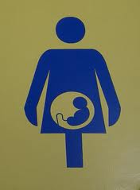
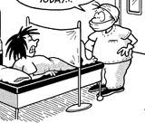
Causes
Prenatal causes
Perinatal causes
Postnatal causes
Google
Notes:
5

Slide 11
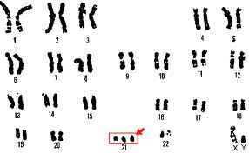
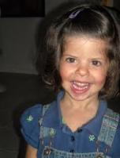
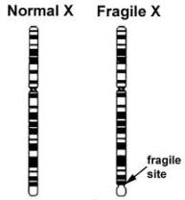
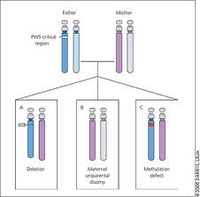
Prenatal causes:
Chromosomal disorders
  Down Syndrome
  Williams Syndrome
  Fragile X Syndrome
  Prader-Willi Syndrome
Google

Slide 12
Prenatal causes:
Inborn errors of metabolism
  Deficiency of enzymes used to metabolize basic substances in the body.
Developmental disorders of brain formation
  Microcephalus
    Small, conical shaped head
  Hydrocephalus
    Enlargement of the head
Environmental influences
  FAS, FAE, Rubella

Slide 13
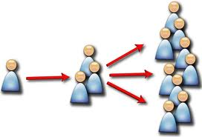
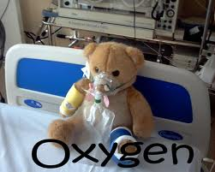

Perinatal causes
Anoxia
Infections passed from mother
Low birth weight
Google

Slide 14

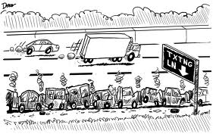
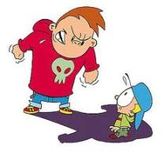
Postnatal causes
Biological postnatal causes
Trauma
Sickness: Meningitis
Psychological postnatal causes
Abuse
Neglect
Under-stimulation
Google

Slide 15
Assessment
Intelligence tests (Mental Age/Chronological Age)
  Cultural factors
  Cautions in using and interpreting IQ tests
    Inconsistent
    Age affected
    Does not test a persons ability to function in society
Adaptive behavior skills
  Parent and teacher reports
    Tests the ability of the person in question to function in society and maladaptive behavior.
Notes:
6

Slide 16
Psychological and Behavioral Characteristics
Areas of Difficulty
Attention
Memory
Language Development
Self-Regulation
Social Development
Motivation

Slide 17
Some Specifics
Working Memory: The ability to remember information while performing another task.
Self-Regulation: The ability to regulate ones own behavior.
Metacognition: The awareness of strategies to be used to perform a task (Thinking about thinking)

Slide 18
Be Aware
Learned Helplessness: The belief that no matter how hard one tries, failure will result.
Small successes lead to empowerment.

Slide 19
Educational Considerations to Build in the Classroom
Autonomy: The ability to act independently.
Self-Regulation: Setting goals, problem solving and monitoring ones own performance.
Psychological Empowerment: Belief that one has control of outcome.
Self-realization: Accurate knowledge of ones strengths and limitations.

Slide 20
What to do in the general education classroom.
Remember: Every student a with an intellectual and developmental disability is an individual with specific strengths and weaknesses.
Evaluate each student as an individual and design a sequence of action to meet their needs.

Slide 21
Relax
As students of the CSU Chico teacher education system you have already learned most of the techniques for teaching students with disabilities.
Best teaching practices for students with disabilities are also best teaching practices for all students. They are simply adapted and modified to meet the needs of a students particular disability.

Slide 22
Best Practices
Approach material using visual aids to clarify such as charts, pictures, graphs.
Analyze complex tasks and break them down to their fundamental parts in a logical sequence.
Master one skill then move to the next building on the concept.

Slide 23
Best Practices Continued
Use extensive physical and verbal prompting to guide outcomes.
Praise to reinforce desired behaviors in class and during assignments.

Slide 24
Adaptations
Provide extra time to think during lessons.
Breakdown tasks into adaptively smaller components depending upon extent of disability.
Progressive Time Delay: Slowly increasing the time between teacher requests and the prompt for completion or assistance. (Used to build independence)

Slide 25
One more important adaptation
Gear lessons towards real life skills that can be used beyond the scholastic environment. (Example: Teach adding with money using a mock store.)

Slide 26
Behavior Support
Praise and Reward desired behavior: At first using instant rewards then progressing to a token reward form. (This aids in teaching students to delay their gratification.)
Ignore undesirable behavior unless it moves to a predetermined non-negotiable level.

Slide 27
Service Delivery Models & Early Intervention
Service Delivery Models:
Range from general education classrooms to residential facilities
Trend toward instruction in integrated settings
Notes:
9

Slide 28
Early Intervention
Two Different Purposes of Preschool Programs:
Early childhood programs designed for prevention (for those at risk for mild mental retardation):
  Include such programs designed in the 1960’s such as:
  the Perry Preschool Program
  the Chicago Child-Parent Center Program
  the Abecedarian Project.
Early childhood programs designed to further development of those identified as mentally disabled (for those with more severe mental retardation):
  Include emphasis on language and conceptual development as these children already have professional in their lives, such as speech and physical therapists.
  Ie. Class-wide Peer Tutoring (student w/ mild disabilities are paired w/ nondisabled student, switching roles half way through the session, w/ modifications in place for the student w/ disabilities for rewards= improved academic performance for all, increased engaged time, positive acceptance from teachers and students).

Slide 29
Perry Preschool Program
123 children born in poverty & at high risk of failing in school, ages 3 & 4, randomly divided into a program group that received high-quality preschool program based on a participatory learning approach along w/ a comparison group who had no preschool.
Later, at age 40, the participants still living were: interviewed, data was collected (subjects' school, social services, & arrest records), & found that those in the preschool program had:
  higher earnings
  were more likely to hold a job
  had committed fewer crimes
  were more likely to have graduated from high school than those not enrolled.
Cost-benefit analysis = $7.16/ $1 invested.

Slide 30
The Chicago Child-Parent Center Program
Services to preschool children and parents in low income areas in/or near low income elementary schools funded by No Child Left Behind Federal Chapter I & Title I funds.
Parents enroll children at age three & the program uses best practices in comprehensive educational services for two continuous years.
Students develop basic reading/writing/math skills.
CPC requires parent involvement in parent room or classroom activities twice a month in activities relating to child growth/development, literacy, readiness skills, parenting skills, health/safety/nutrition.

Slide 31
The Abecedarian Project
Controlled study of benefits of early childhood education for poor children.
Four cohorts from low-income families born between 1972 and 1977 randomly selected while in the womb & assigned as infants to receive ½ day in a childcare setting from infancy through age 5 and ½ to a control group with no preschool.
Day-care children had individualized educational activities incorporated into the child's day that focused on social, emotional, and cognitive areas of development with emphasis on language.
Progress monitored over time at ages 12/15/ 21 with findings demonstrating benefits like:
  Better scores on Intellectual/academic measures
  > likely to attend 4 yr colleges

Slide 32
Transition to Adulthood
Person-centered planning = a type of transition model, consumer-driven in that professionals are viewed as working for individuals (individuals make decisions with respect to services to meet their goals
Two Areas of Involvement:
Community adjustment = individuals need to acquire skills in the area of self-help to adjust to living in the community, living with family/community residential facilities/ or supported living
Employment
  Sheltered workshops= structured environment where they can learn skills.
  Supported competitive employment= work for minimum wage among those not disabled and assisted w/ a job coach (provides various help)

Slide 33
Things to consider in Transitioning
The guiding principle = promotion of person-centered planning (the person w/ the disability has voice)
Transition programming involves two main areas:
  Community skills
    Managing money
    Using public transportation
    Maintaining living environments
    (Large residential facilities are getting out-dated and community residential facilities (CRF’S) are in)
    Some live in supported living arrangements w/ people w/ disabilities live in their own home or apartment
  Employment
    Sheltered workshops (structured training w/ other workers w/ disabilities requiring low skills)
    Supported competitive employment (receiving at least minimum wage w/ workers that are not disabled, accompanied by assistance from a job coach)

Slide 34
Prospects for the Future
Employers are taking a more favorable view of hiring a person with a disability because:
Development of innovative transitional programs
Many are achieving levels of independence in both living arrangements and in the workplace
Success is largely due to collaboration of:
  Parents
  Students
  professionals

